Slide 1



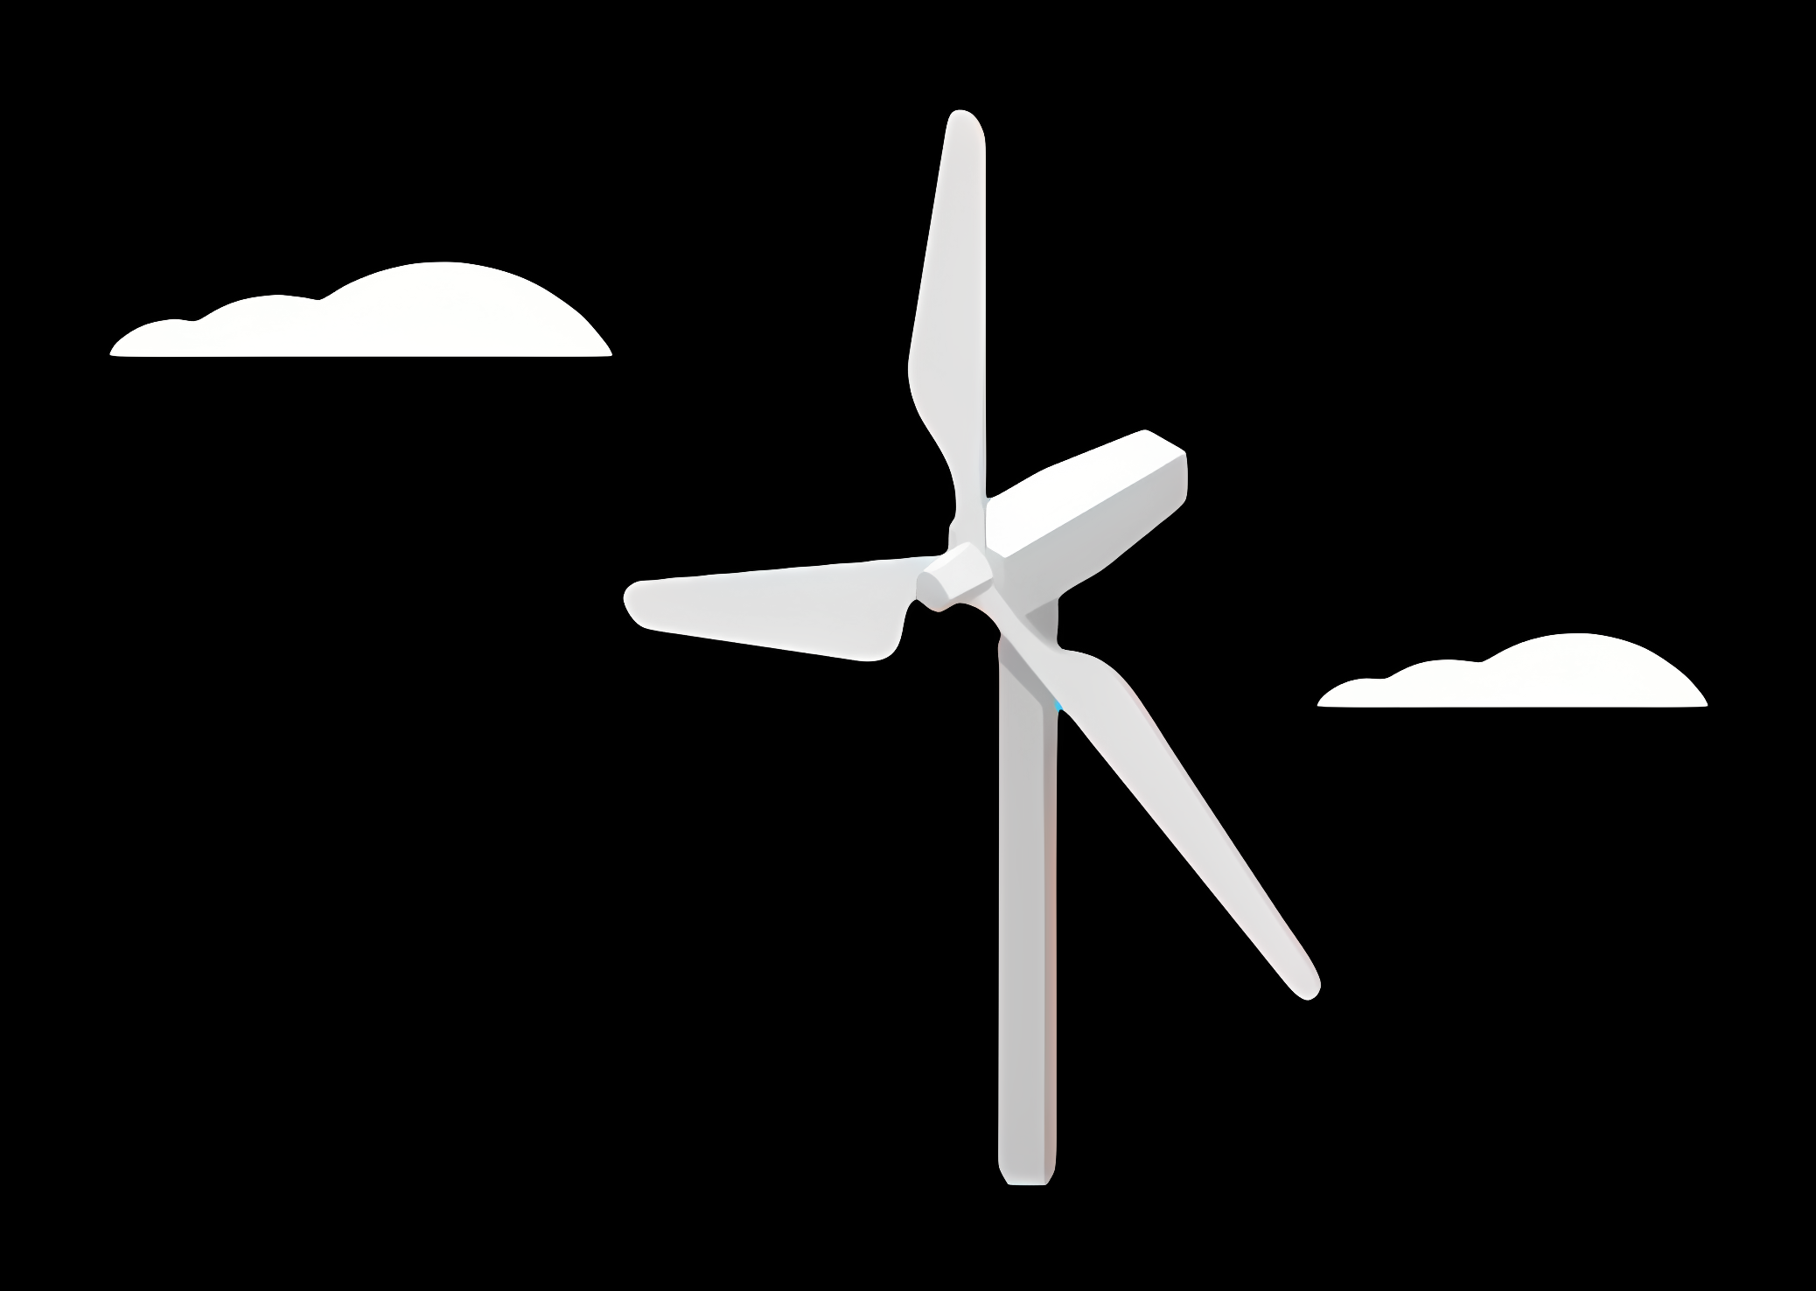
Weekly report: Wind Turbine Foundations
Week number:2
Date: 30/09/2025
Supervisor : Prof. Dr.-Ing. Torsten Faber
Group members: Jehad Albaali - Reda Deif- Amagad Gerges

Slide 2
Sharing of Work
Jehad Albaali
Leading the team
Making research of the sites and the soil Type
Preparation of reports
Prepare the power point with input
Amagad Gerges attended the meetings
Helping with research
Reda Deif
Helping with research
Writing the reports
Helping with power point Presentation

Slide 3
Foundation
Content
Foundation Types & Design Factors
Site Analysis
Soil Improvement
Reference

Slide 4
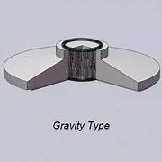
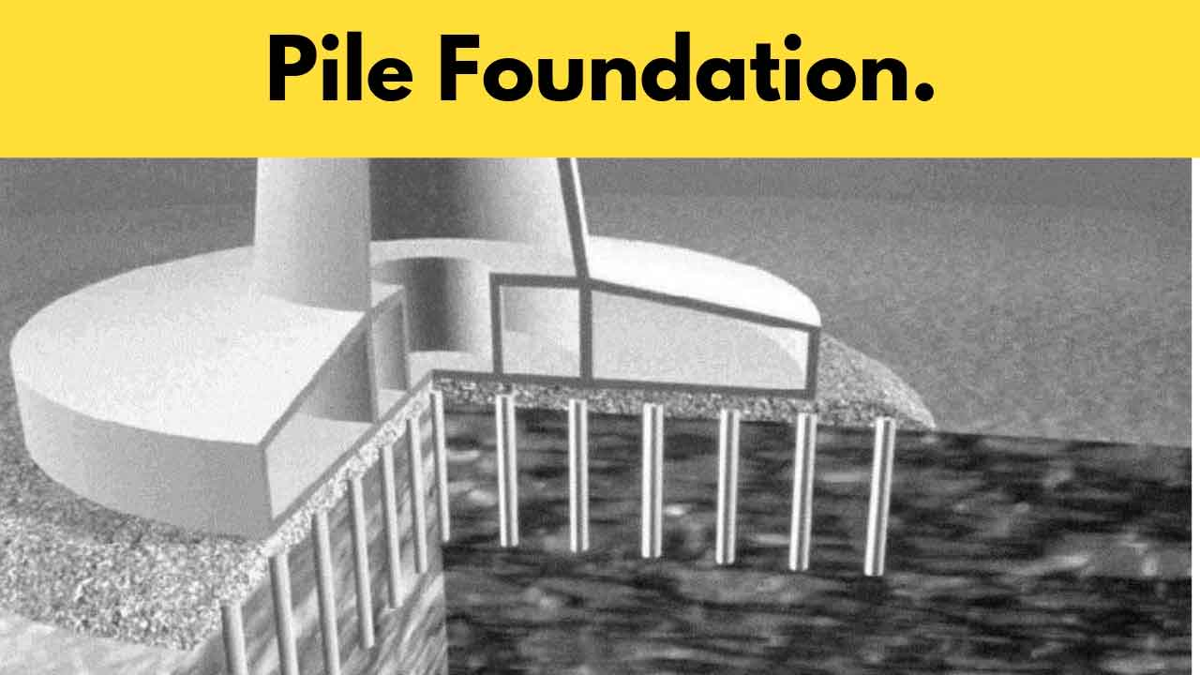
Foundation Types & Design Factors
• Shallow: Gravity, Piled raft
• Deep: Piles, Monopiles, Rock foundations
• Key factors: Soil type, Loads, Groundwater, Environment, Cost

Slide 5
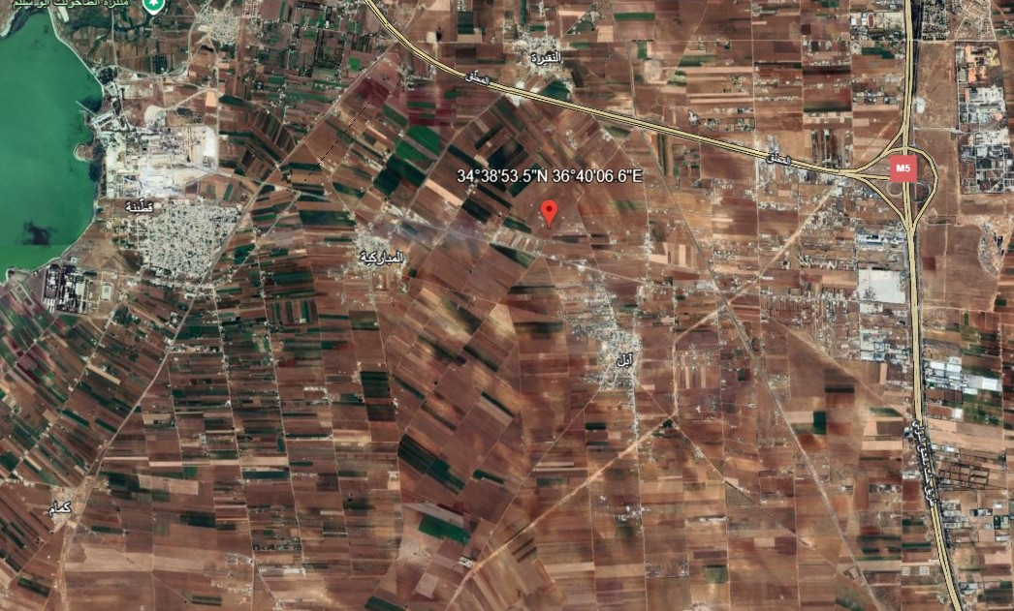
Site Analysis Qatina ,Umm Al-Azam and Ghabagheb.
• Qatina (34.6482°N, 36.6685°E): Clayey/Marly soil, weak bearing, high groundwater. Options: Piles or large gravity with ground improvement.

Slide 6
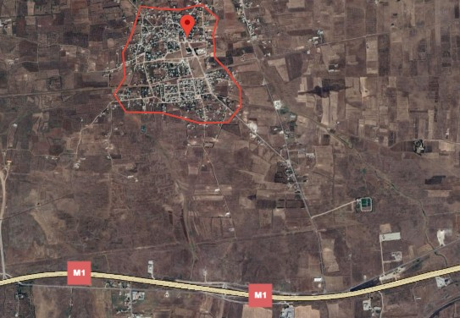
Site Analysis Qatina ,Umm Al-Azam and Ghabagheb.
• Umm Al-Azam (34° 4148.4" N 36° 3032.5" E): Clayey/Marly soil, weak bearing. Options: Piles or large gravity with ground improvement.

Slide 7
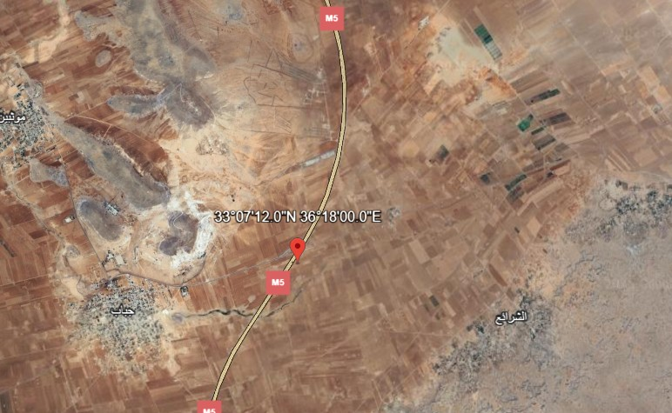
Site Analysis Qatina ,Umm Al-Azam and Ghabagheb.
• Ghabagheb (33.12°N, 36.30°E): Flat plains, clayey/loamy soils. Gravity foundations possible, piles if compressible.

Slide 8
Site Comparison – Soil & Topography
Site | Soil Type (SoilGrids) | Composition (Sand/Silt/Clay %) | Topography | Foundation Implications
Qahtina | Silty Clay | ~18–20 / ~33–37 / ~43–49 | Flat /plain | Weak soil → piles or improvement
Umm Al-Azam | Silty Clay | ~20 / ~35 / ~43–45 | Flat/plain | Weak soil → piles or improvement
Ghabagheb | Clay Loam – Silty Clay Loam | ~20–30 / ~30–35 / ~35–45 | Flat/plain | Piles or improvement

Slide 9
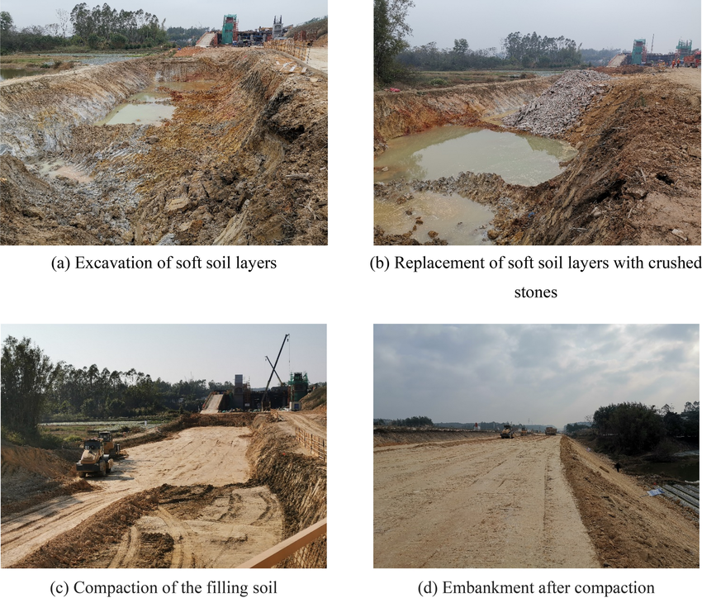
Soil Improvement for Gravity Foundations
• Soil Replacement: remove weak soil (2–3 m) and replace with compacted gravel/stone.
• Dynamic Compaction: drop heavy weights to densify soil (effective in sandy/silty soils).
• Stone Columns: drilled columns filled with compacted gravel → increase bearing + drainage.
• Grouting: inject cement/mortar to strengthen weak zones or voids.
• Geogrid Reinforcement: place geogrid under gravity foundation to spread loads.

Slide 10
Soil Improvement for Gravity Foundations
• Soil Replacement: remove weak soil (2–3 m) and replace with compacted gravel/stone.
• Dynamic Compaction: drop heavy weights to densify soil (effective in sandy/silty soils).
• Stone Columns: drilled columns filled with compacted gravel → increase bearing + drainage.
• Grouting: inject cement/mortar to strengthen weak zones or voids.
• Geogrid Reinforcement: place geogrid under gravity foundation to spread loads.

Slide 11
Next Tasks
Confirm the selected site for turbine installation.
Define the foundation type according to the tower design and soil conditions.
Coordinate with the loads team to obtain load figures (vertical, horizontal, overturning).
Prepare preliminary foundation sizing based on soil and load data.

Slide 12
Bibliograpy
Document sources:
Source 1: https://civilseek.com/pile-foundation/
Source 2: http://www.steelwindtower.com/onshore-wind-tower-foundation-types/
Source3:https://www.researchgate.net/publication/367098142/figure/fig11/AS:11431281113021056@1673668616739/Weak-soil-replacement-process.png
Source4: https://kawngroup.com/wind-farm-designing/
Source5: https://www.scribd.com/document/652447793/%D9%87%D9%86%D8%AF%D8%B3%D8%A9-%D8%A7%D9%84%D8%A7%D8%B3%D8%A7%D8%B3%D8%A7%D8%AA
Source6: https://earth.google.com/web/search/33.12%c2%b0N,+36.30%c2%b0E/@33.12981927,36.29319581,631.18487639a,23748.39131789d,35y,0h,0t,0r/data=CloaLBImGY_C9Shcj0BAIWZmZmZmJkJAKhIzMy4xMsKwTiwgMzYuMzDCsEUYASABIiYKJAkAx4cNpl1BQBFZ8yO911VBQBlExi5CXUtCQCE3dnX6EDhCQEICCAEyKQonCiUKITFJaHRMSkpmX1YxXzgwcVRNcmhKUGRqOWZiZ0lOaGdlVyABOgMKATBCAggASggIoMLS4wIQAQ
Source7: SoilGrids250m 2.0

